Slide 1

From Cmdlet to Function – Your PowerShell Beginnings
Mike Nelson
Level: Beginner

Slide 2

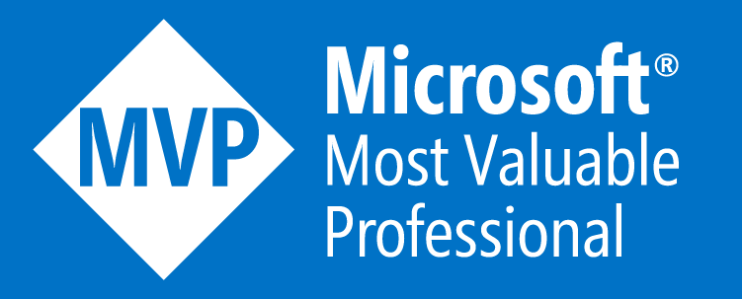
Mike Nelson
Solutions Technologist @ Rubrik
@nelmedia
mike@mikenelson.io
Microsoft MVP, Azure Advisor, VMware vExpert, Citrix CTA

Slide 3
Get-Content
PowerShell Basics
Functions & More
The Demo
Creating a script
Your first Function
Morphing into a Module

Slide 4

HOW IT STARTED
Jeffrey Snover, Bruce Payette, & James Truher
Project Monad in 2002

Slide 5
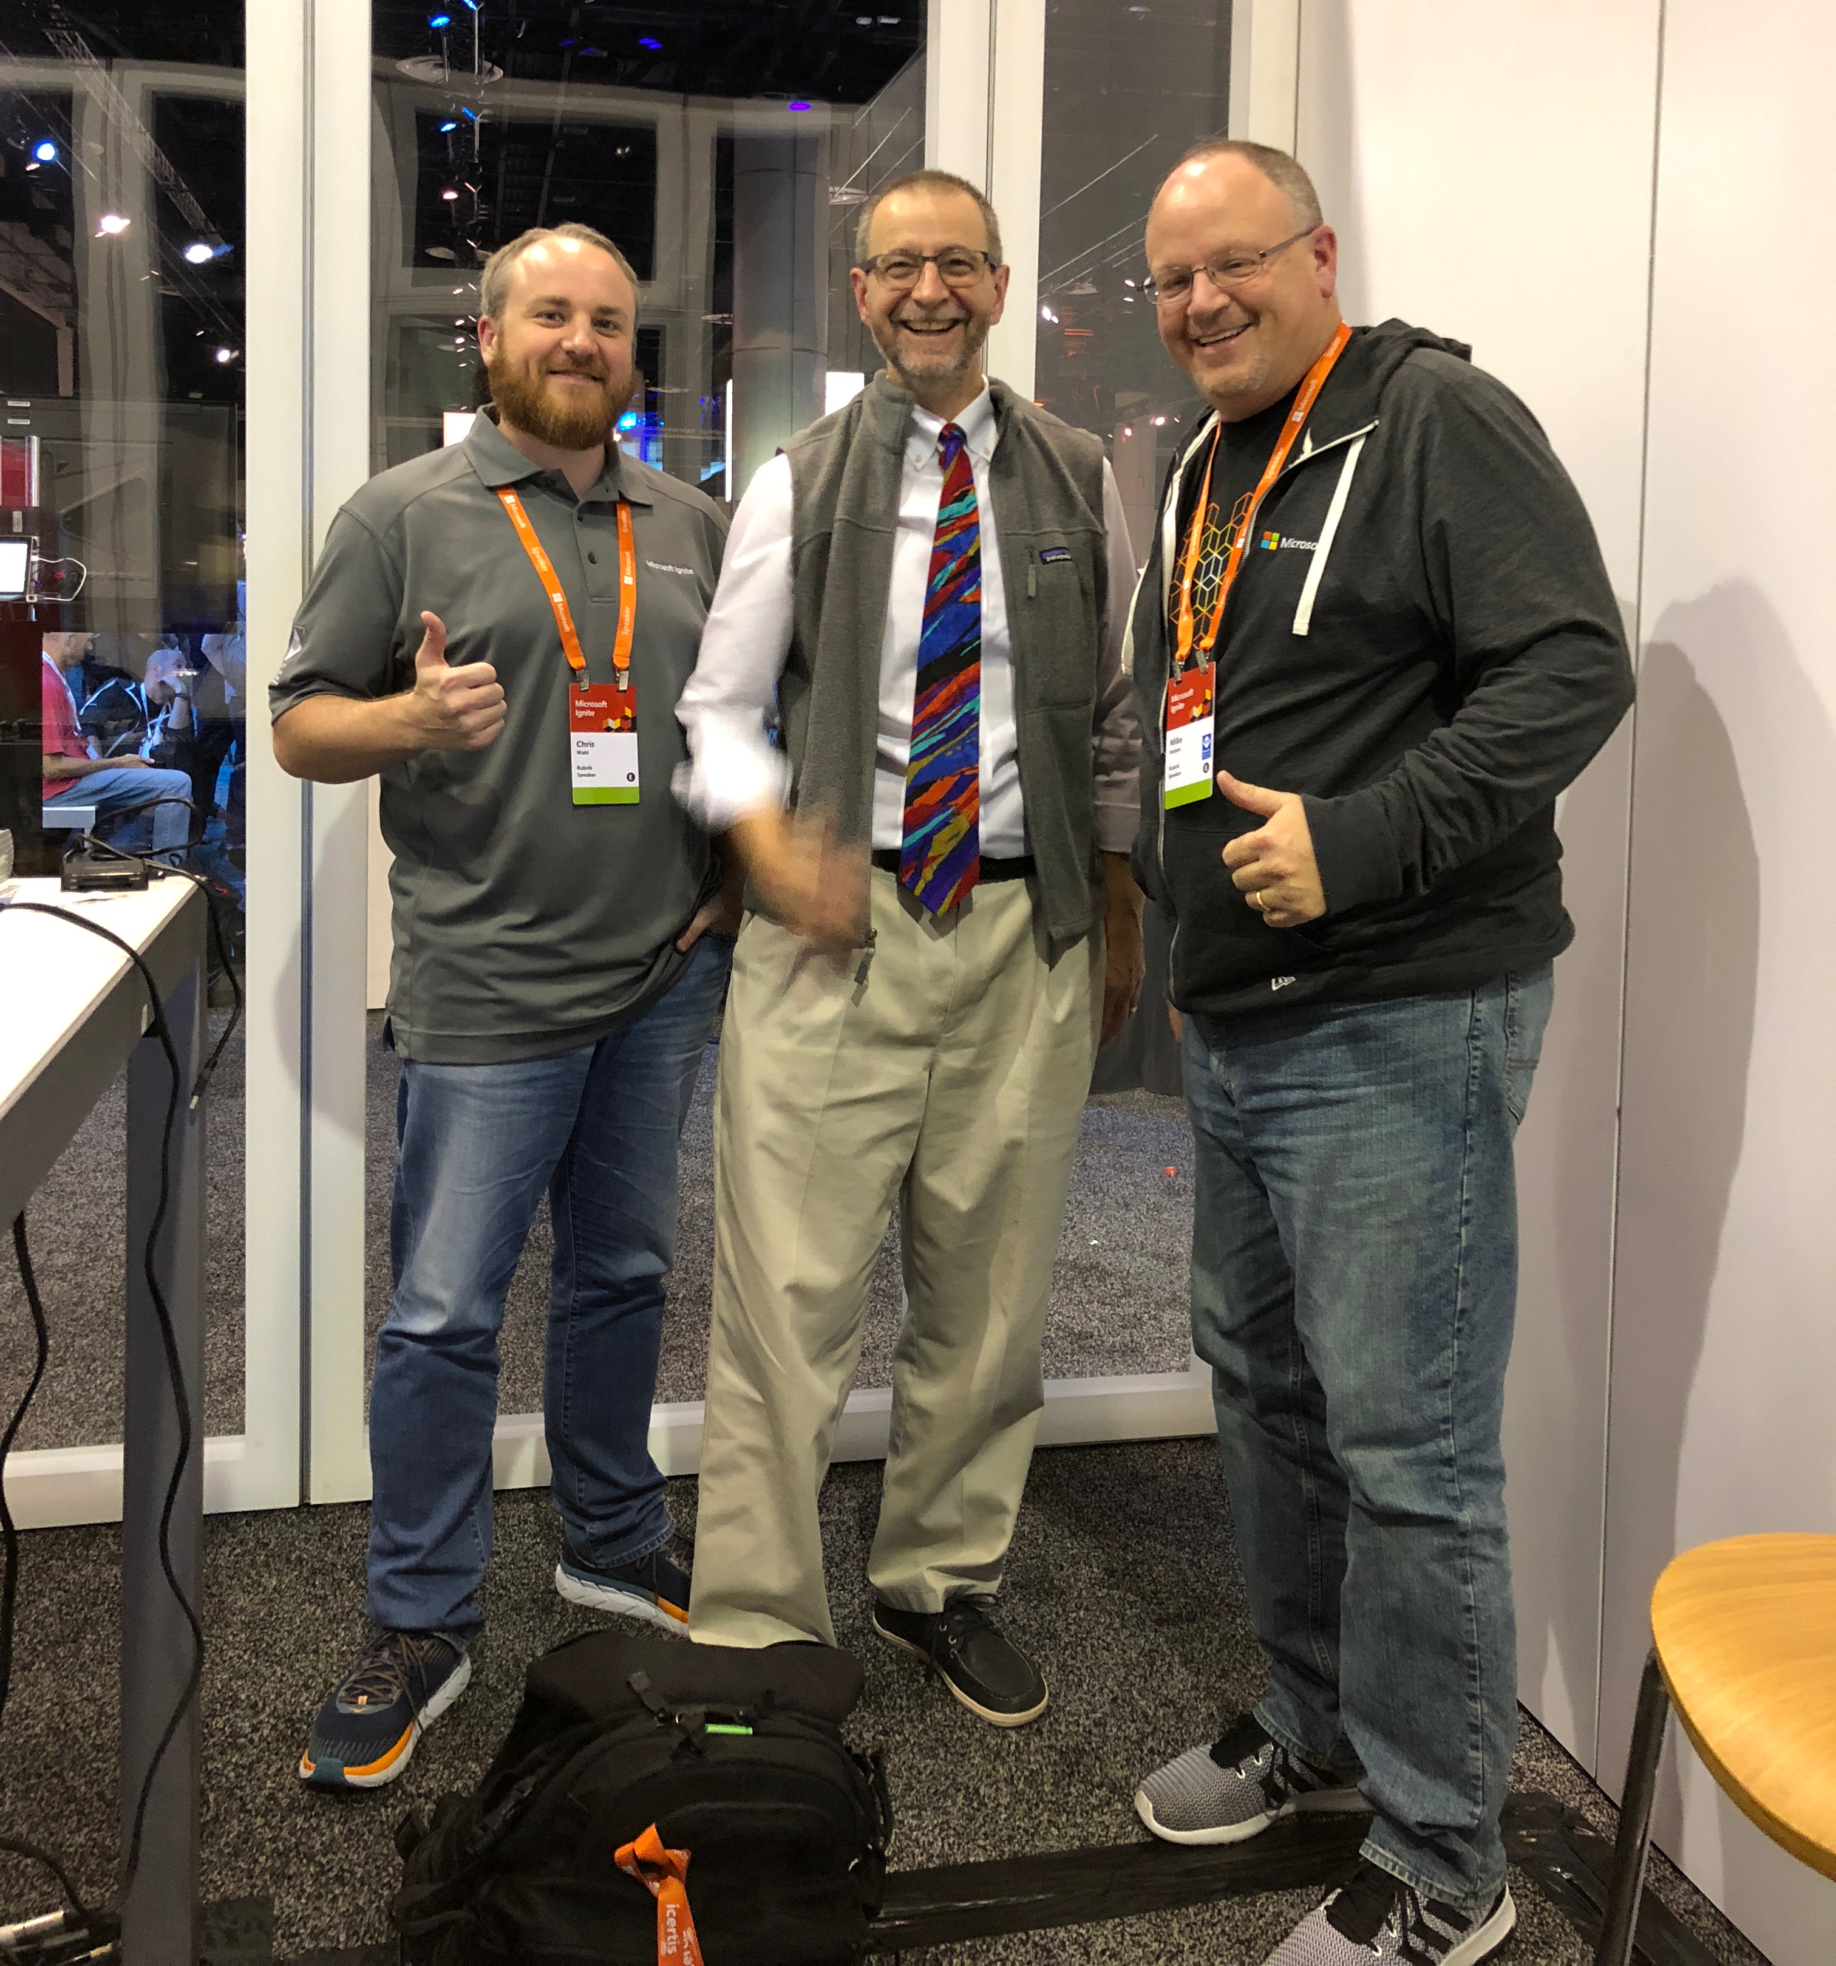
Snover Quotes
“This is rock science, not rocket science.”
“I took a demotion to create PowerShell.”
“PowerShell is a such a great product because I am a deeply flawed human being.”
“Not updating from WS2003 is like the guy who jumps off a building and on the way down says, "so far, so good!“
“When in trouble, fear, or doubt - run in circles, scream, and shout.”
Notes:
Cscript was early beginnings
Microsoft Shell or MSH was next.

Slide 6




VERSIONS
5.1
Core
PowerShell 7
Notes:
Core will not replace 5.1 for now. 5.1 will only get fixes and security updates. Why?
Core will become PowerShell 7 (Core name removed)

Slide 7
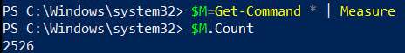
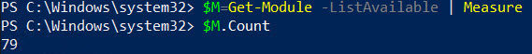
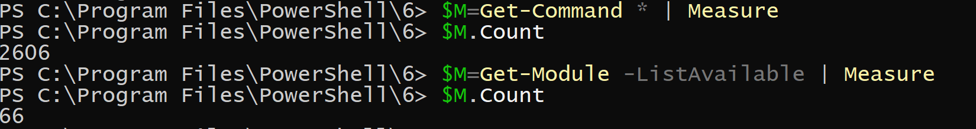
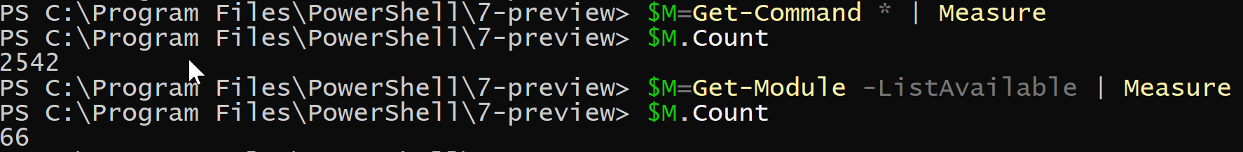
5.1
6.2.2
7.0p2

Slide 8
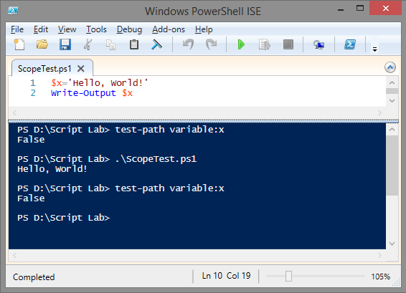
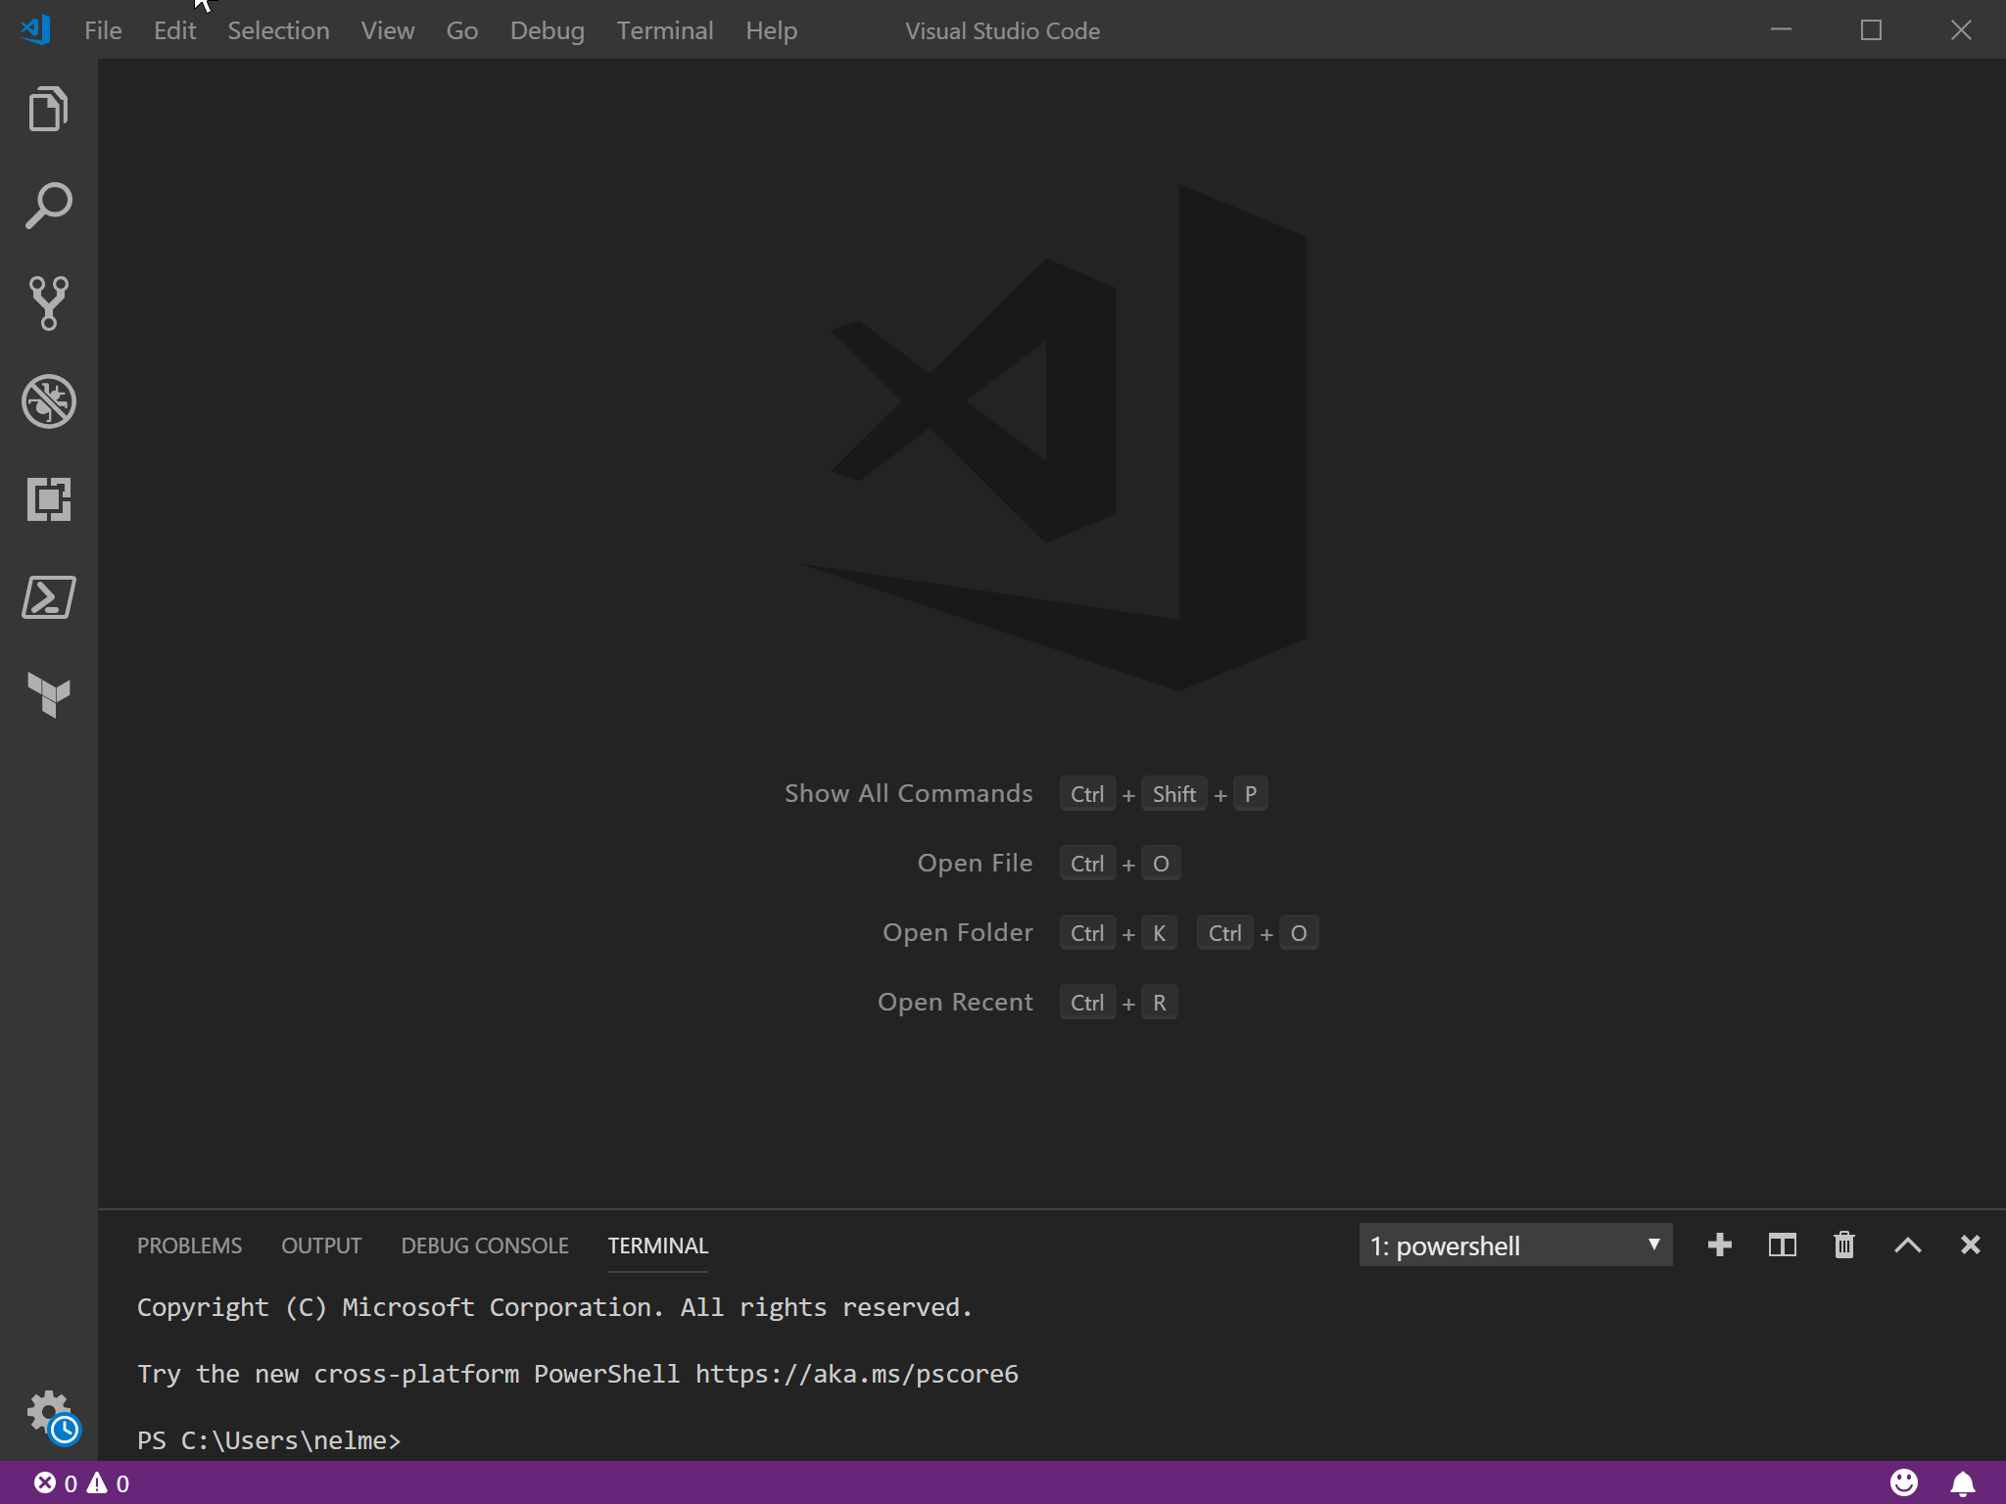
ISE
VSCode

Slide 9

SYNTAX
Positional Parameter
Switch Parameter
Verb
Noun
Cmdlet
Named Parameter

Slide 10
CORE COMMANDS TO HELP LEARN
Get-Command
Get-Help
Update-Help
Get-Member
Show-Command

Slide 11
LET’S MAKE IT EASY
😉
PowerShell Gallery
Easy find, install, & update of Modules
Chocolatey
Easy updating of Core (and more)
Github search
Always give credit

Slide 12
“Create documented and reusable code, you will.”
- PowerShell Yoda

Slide 13
FUNCTIONS
A list of statements you define
function helloworld { Write-Host ‘Hello World!’ }
You then simply call the function
Statements then just run like you typed them
Functions can be in scripts, modules, profiles, and “called” from scripts

Slide 14
MODULES
A package of commands in a .psm1 file
PS>New-Module is one way
3 kinds
Script – psm1 files that contain any valid PowerShell code
Binary – compiled DLL’s
Dynamic – only available in memory
Manifest (optional) – .psd1 file that describes a module, syntax & requirements, & how it is to be processed
PS>New-ModuleManifest
PS>Test-ModuleManifest
When would you / should you create a module?
Notes:
When do I create a PowerShell module?
You can easily decide whether to create a module by answering the following questions while writing a script:
Will the code I'm writing need to be used more than once?
Does this code essentially manage a single object or entity?
As I write this code, do I find that I'm breaking it apart into functions because it's getting too complex to be in a single script?
Do I need to share the code with others?
If you answered yes to at least three of these four questions, it's a good bet you should be writing a module instead of a PS1 script.
Module Manifests contain verbose information as well as any specifying of extra or necessary files for the module, such as XML or JSON.

Slide 15
PIPELINES
Connecting commands together
PS>Get-Process | Out-Host -Verbose
Reduce the effort of writing long, complex commands
Can utilize pipeline variables ( $_ or $PSItem )
Commonly used in “one-liners”

Slide 16
Let’s Create a Module!

Slide 17
What are we going to do?
Start by seeing some basics
Create a script that runs an alarm clock
Turn that script into a function
Take that function & create a module

Slide 18

THANKS!
Any questions?
You can find me at
@nelmedia
mike@mikenelson.io

